Slide 1
Named Entity Recognition on Contextual Entities in Family History Records
Daniel Segrera

Slide 2
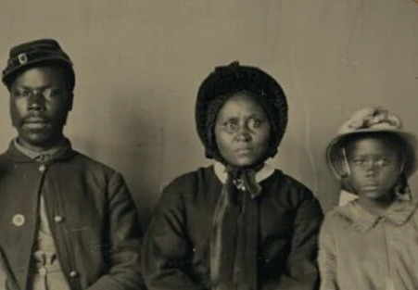
What problem do we want to solve?
Family history work is important to many organizations
It helps people learn about their heritage and form connections with their ancestors
To find facts about ancestors organizations extract information from historical documents in a process sometimes called indexing

Slide 3

What problem do we want to solve?
Unfortunately, manual indexing is very slow
This problem is even more pronounced for records written in languages with less manual indexing efforts such as Czech

Slide 4
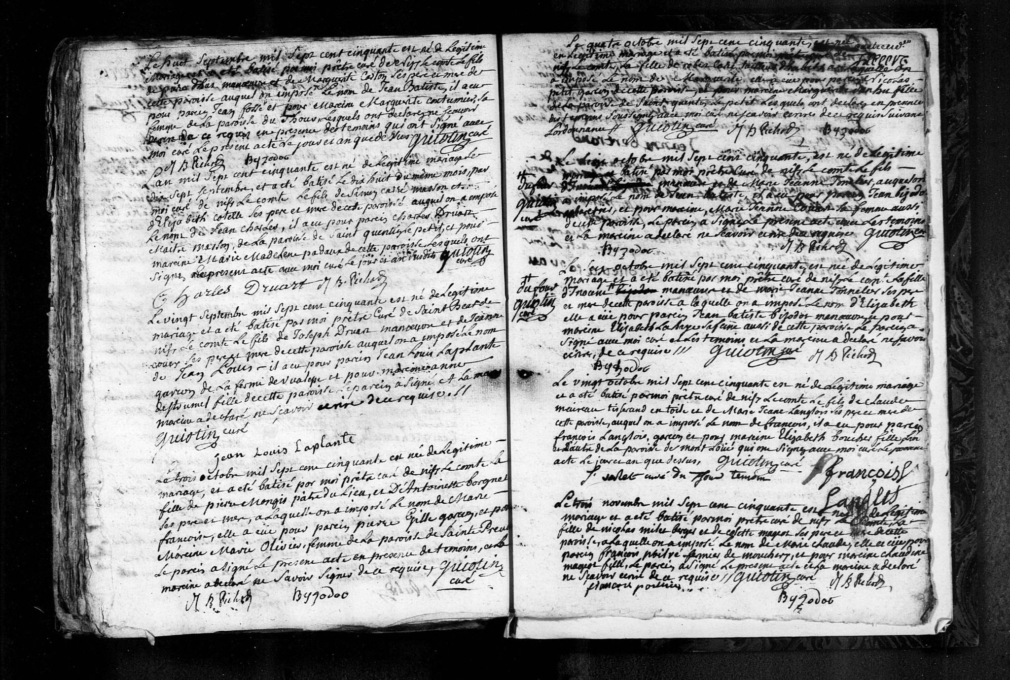

Slide 5
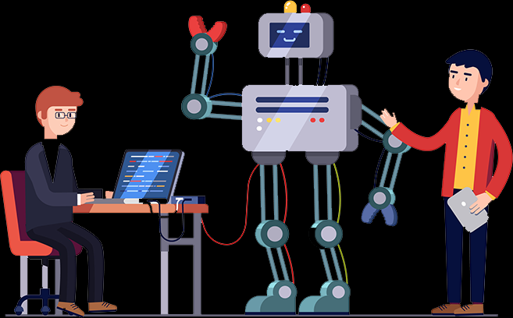
What problem do we want to solve?
Many organizations are attempting to automate the indexing of historical documents
Free form records are more difficult to automatically index
The most obvious way to solve this problem is to perform a process called Named Entity Recognition (NER)

Slide 6
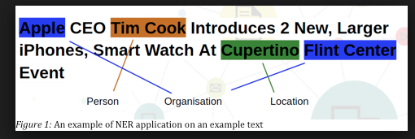
What is Named Entity Recognition (NER)?
Entity:
any key piece of information referred to in the text
Named Entity Recognition (NER):
the process of identifying and classifying entities presented in a text document
Also called entity extraction

Slide 7
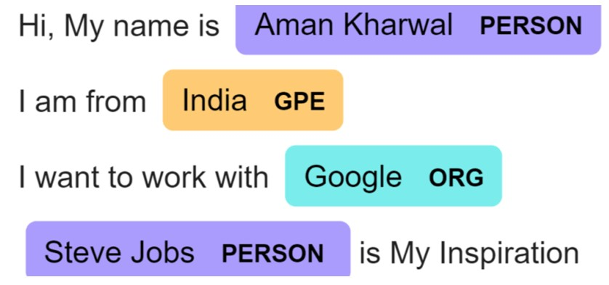
What is Named Entity Recognition (NER)?
NER classifies according to broad categories such as persons, places, dates, etc.
The categories are effectively supersets of contextual subsets such as brothers, birth places, marriage dates, etc.

Slide 8
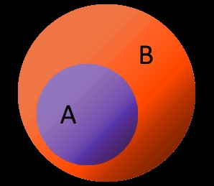
What is Named Entity Recognition (NER)?
These supersets we call coarse-grained classes and the subsets we call fine-grained classes
NER typically classifies entities into coarse-grained classes

Slide 9
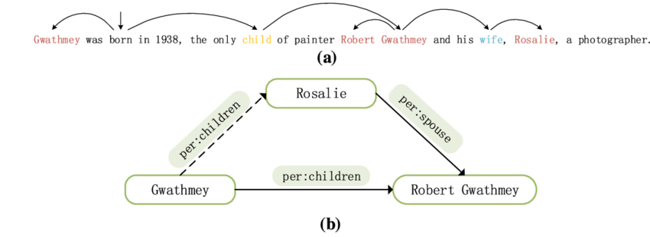
So why is NER insufficient?
Unlike most NER tasks the key information in a family record is highly contextual to the relationships between the entities within the record
So we need our entities to be classified into relational (i.e. fine-grained) classes

Slide 10
So why is NER insufficient?
To classify relational classes you not only need to identify entities you need to extract the relationships between them:
Name Name
Paul and James Thompson ran to the store to get milk for their parents.
Paul Sibling_of James Thompson
To do this a process called Relation Extraction will be needed

Slide 11
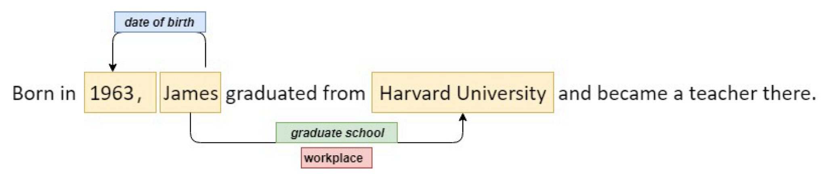
What is Relation Extraction?
Relation Extraction:
the process of identifying and classifying relations between entities in a text document

Slide 12

So how do we solve this problem?
We can create a joint model that uses NER to find entities and Relation Extraction to map their relationships
Doing this allows the model to classify entities into relational classes

Slide 13
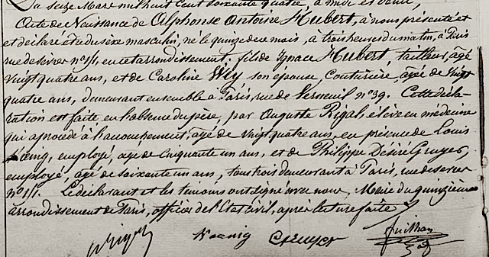
Dataset
270 French Birth Records and Marriage records
provided by Ancestry.com
60/20/20 train/val/test split
400 synthetic records
generated though data augmentation
added to the training set

Slide 14
Joint Entity-Relation Extraction Model
Text in dataset is tokenized
The training dataset is run through the Entity Extraction model.
For each record it pairs every combination of the predicted entities.
Example pair (tuple): [dog, girl]

Slide 15
Joint Entity-Relation Extraction Model
This generates triplet tuples that represent the predicted relationships between entities.
These triplet tuples can then be used to infer the fine-grained labels of the entities.
Example triplet tuple: [dog, next_to, girl]

Slide 16
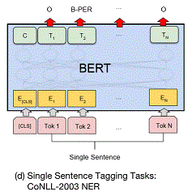
Joint Model: Entity Extraction
Uses the transformer based model BERT to classify entities

Slide 17
Joint Model: Entity Extraction Results
Confusion Matrix
Performance Metrics
 | None | Name | Date | Gender | Age
None | 4234 | 20 | 10 | 1 | 10
Name | 37 | 1388 | 0 | 0 | 0
Date | 1 | 0 | 451 | 0 | 0
Gender | 0 | 0 | 0 | 43 | 0
Age | 0 | 0 | 0 | 0 | 211
 | Precision | Recall
None | 0.9911 | 0.9904
Name | 0.9858 | 0.9740
Date | 0.9783 | 0.9978
Gender | 0.9773 | 1.0000
Age | 0.9548 | 1.0000

Slide 18
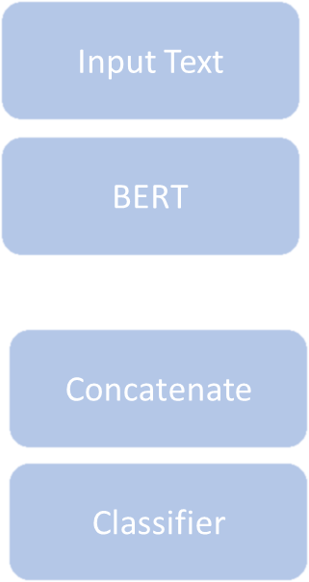
Joint Model: Relation Extraction
Most Relation Extraction Models:
Processes one sentence at a time
Processes pairs of entities separately
Cascaded model compounds error
However historical documents typically:
Consist of more than one sentence
Contain at least 10 entities

Slide 19
Joint Model: Relation Extraction
Uses end-to-end model to avoid cascading error
Uses BERT to extract relationships
Processes entire record at once to prevent context loss

Slide 20
Joint Model: Relation Extraction
BERTs extract context-dependent embeddings.
Then the model classifies relationships based on the embeddings between tokens

Slide 21
Joint Model: Relation Extraction
Predefined relations:
(Any) None (Any)
(Name) Father_of (Name)
(Gender) Gender_of (Name)
(Age) Age_of (Name)
(Date) Birth_of (Name)
(Name) Mother_of (Name)
(Name) Spouse_of (Name)
(Date) Marriage_of (Name)

Slide 22
Joint Model: Relation Extraction Results
Confusion Matrix
Performance Metrics
 | None | Gender | Age | Father | Mother | Spouse | Birth | Marriage
None | 351 | 0 | 13 | 6 | 2 | 0 | 0 | 0
Gender_of | 0 | 25 | 0 | 0 | 0 | 0 | 0 | 0
Age_of | 3 | 0 | 121 | 0 | 0 | 0 | 0 | 0
Father_of | 0 | 0 | 0 | 61 | 3 | 1 | 0 | 0
Mother_of | 0 | 0 | 0 | 1 | 64 | 0 | 0 | 0
Spouse_of | 0 | 0 | 0 | 0 | 0 | 50 | 0 | 0
Birth_of | 1 | 0 | 0 | 0 | 0 | 0 | 19 | 0
Marriage_of | 0 | 0 | 0 | 0 | 0 | 0 | 0 | 10
 | Precision | Recall
None | 0.9414 | 0.8993
Father_of | 0.9444 | 0.9659
Gender_of | 1.0000 | 1.0000
Age_of | 0.9391 | 0.9776
Birth_of | 0.9592 | 1.0000
Mother_of | 0.9650 | 0.9375
Spouse_of | 0.9732 | 0.9732
Marriage_Of | 1.0000 | 1.0000

Slide 23
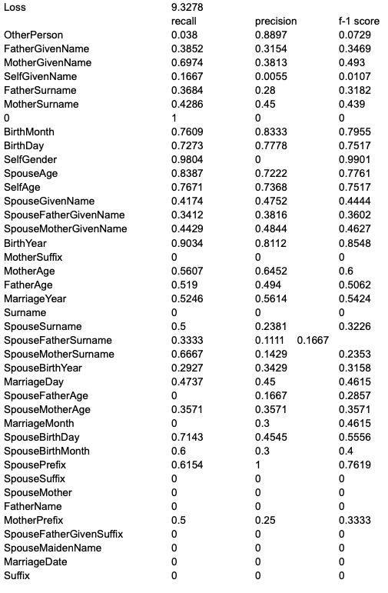
Previous Results (results when not using this method)

Slide 24
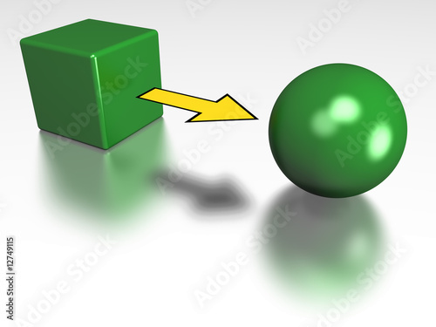
Joint Model: Post Processing
Not yet implemented
After relation extraction, entity-relation triplet tuples are converted into fine-grained relational classifications

Slide 25
Joint Model: Post Processing
Examples:
[“Susan”, Spouse_of, “Ted”] becomes:
[“Ted”, SelfName]
[Mary, SpouseName]
[“February 2nd 1990” , Marriage_of, “Ted”] becomes:
[“February 2nd 1990”, MarriageDate]
[“Thirty”, Age_of, “Ted”] becomes:
[“Thirty”, SelfAge]
[“Male”, Gender_of, “Ted”] becomes:
[“Male”, SelfGender]

Slide 26

Next Steps
Limit token span for potential longer records so that BERT can still be used on them (only 512 tokens allowed at a time)
Test accuracy of final output (relational classifications) of the joint model
Test on more robust and diverse datasets

Slide 27

Conclusions
The joint model trains quickly
Amazing performance so far
End-to-end model avoids cascading error

